Slide 1
PP2 Workshop Project Requirements

Slide 2
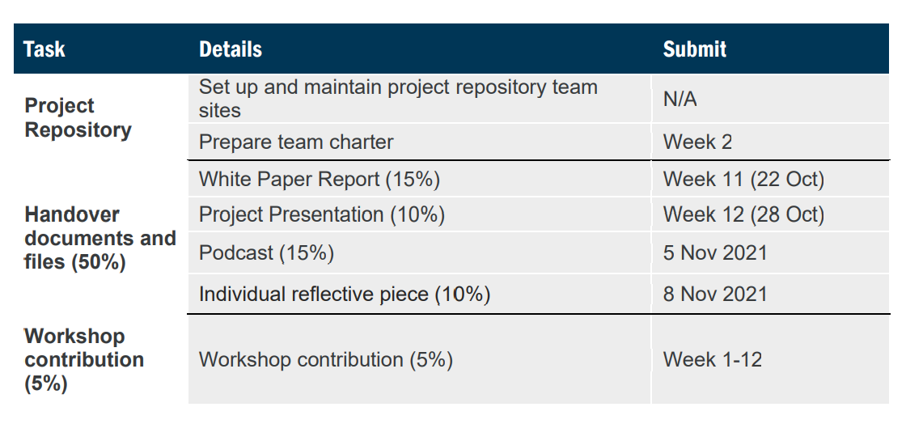

Slide 3
Group Repository and Team Charter

Slide 4
Group Repository & Team Charter
Worth: -
Due: Week 2
Update as Appropriate.

Slide 5
White Paper Report

Slide 6
Worth: 15%
Due: 22 Oct 2021
White Paper Report
Groups will be required to submit a copy of a white paper report.
This is different from reports or articles you usually write. A white paper is an authoritative report, usually created to educate the reader. They delve deep into the subject of study, by offering a broad analysis.
A good white paper will outline its purpose from the outset to evaluate the issues surrounding the set topic within a given context, highlight the challenge, and deliver a solution.
A white paper report should contain key takeaways and its structure should be as clear as possible, with a title page, an easy-to-read table of contents, an overview of the problem that will be addressed, solutions to the problem and a conclusion.

Slide 7
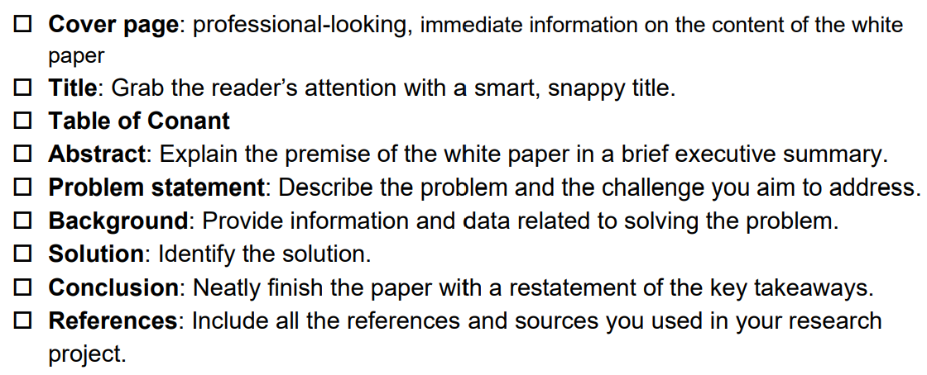
Worth: 15%
Due: 22 Oct 2021
White Paper Report

Slide 8
Worth: 15%
Due: 22 Oct 2021
White Paper Report
Challenge Assessment
What are the key words in the project challenge?
Evaluate the most recent articles and news in the field related to these key words, themes, topics or concepts.
What are the recent innovations that relate to your project challenge? They could be technological, behavioural, or cultural. What is the edge needed for your research or solution?
Take a look at other solutions relating to your project challenge. Which ones worked? Which ones didn’t? Are there any that feel similar to what you propose to investigate as part of the research design? Any solutions that have inspired you to possibly use or adapt?

Slide 9
Worth: 15%
Due: 22 Oct 2021
White Paper Report
Situation assessment
Include a description of the relevant environmental conditions affecting the client business, including relevant statistics, trends, competitors, etc (macro level)
Who is the client base? Outline the trends, relevant statistics and information relevant to the project. (micro level)
Assess how the business needs in relation to the project challenge are currently being met (strengths) or not met (weaknesses). What can be improved? - Analysis of the gap between the current situation and the stated objective(s). What opportunities does this create?

Slide 10
Project Presentation

Slide 11
Worth: 10%
Due: 28 Oct 2021
Project Presentation
Each group presents a 10-minute presentation
It must responds to team project work (Week 12).
Students to submit 1 copy per project team to case-study project presentation link via Wattle:
1 x PDF/PPT version of your presentation
I will check the uploaded docs and liaise with the team representative if there is any need for follow up regarding the doc submissions before your workshop session.

Slide 12
Podcast

Slide 13
Worth: 15%
Due: 5 Nov 2021
Podcast
Each group must produce a Podcast from your learning journey about the project.
Students are encourage to use your maximum creativity in podcasting by engaging with the topic aurally and orally. By engaging the senses more deeply, they can also gain a more comprehensive understanding of the topic.
Students figure out the structure of the episode in their group discussion and decide how to incorporate music and other audio to make it more engaging.
They can use different styles (e.g. the conversational, journalistic, etc) to think outside the box in terms of presentation.
We encourage students to check Radio services like NPR and the BBC to find good examples of engaging, informative programming for your podcast.
The podcast should contains a solid 10 minutes of good content that delivers on its title and engages the audience with the message and story about the project.

Slide 14
Individual Reflective Piece

Slide 15
Individual Reflective Piece
Worth: 10%
Due: 8 Nov 2021
In this assignment students will work individually to write a reflective piece (<700words) about their personal journey during complementing the ‘responsible innovation project’.
The assessment provides them with a way of evaluating skills and competencies on a project that they have been involved throughout the semester. This is very similar to ‘career episode piece’ assignment in PP1.
The assignment provides students with an opportunity to develop reflexivity about their own practices and learning, and to develop succinct reflective writing capability. Such a skill is particularly important for job readiness, including in formulating effective job applications.
This assignment helps students to improve their skills in writing, including refining, structuring and presenting your position and argument.
Please ensure in the reflective piece answers the following question:
What does it take to be responsible when you develop a solution to a problem?

Slide 16
Workshop Contribution

Slide 17
Workshop Contribution
Worth: 5%
Due: Week 1 -12, Sem 2, 2021
If you do no turn up to a class you will not have the opportunity to earn these marks.
If you do not engage in class you will not have the opportunity to earn these marks.
If you do not contribute to discussions you will not have the opportunity to earn these marks.
If you do not engage with your peers on your workshop project, you will not have the opportunity to earn these marks.

Slide 18
Challenge Set: HoloLens

Slide 19
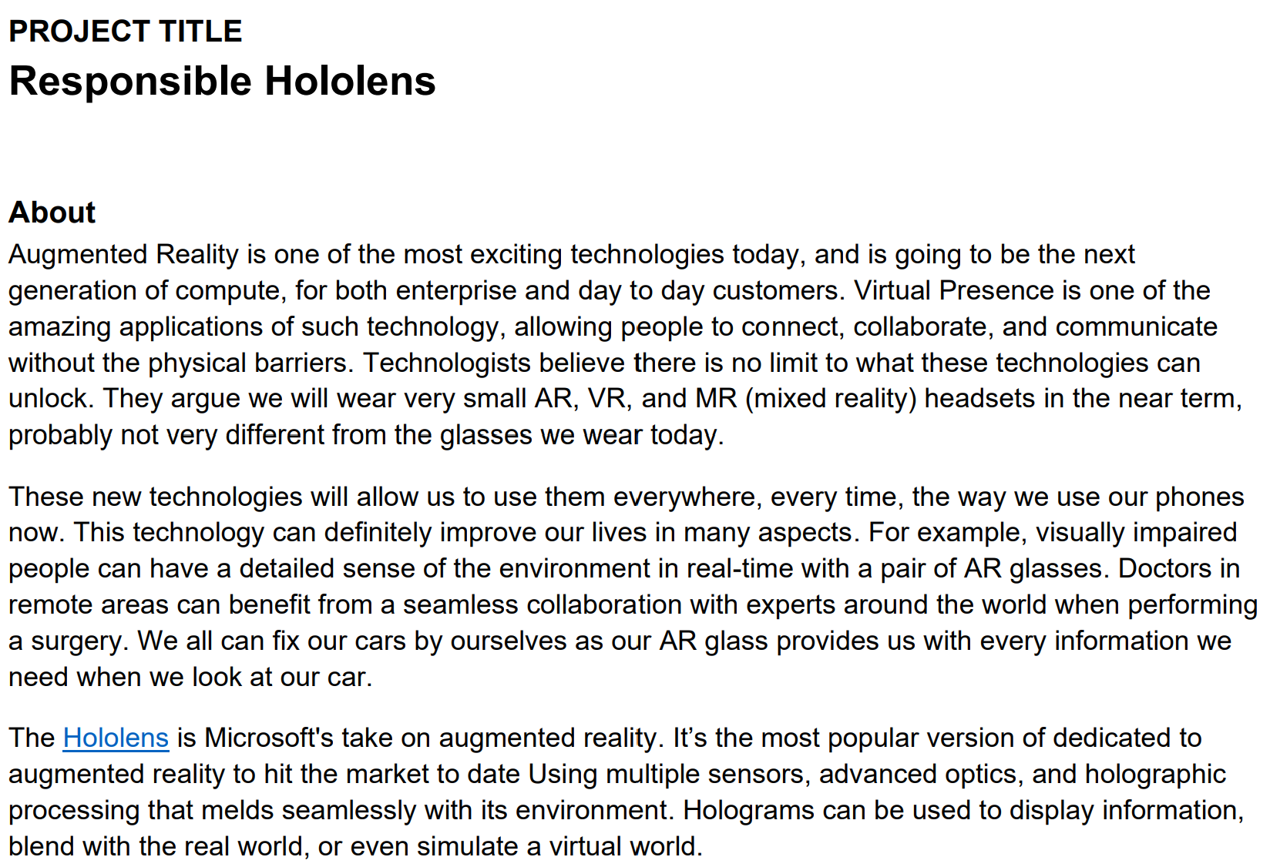

Slide 20
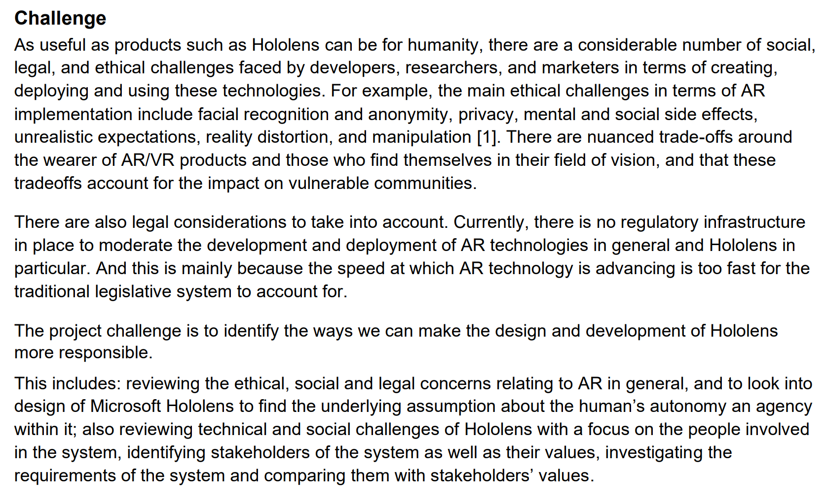

Slide 22
Workshop Project Requirements
 | Yes / No | How has this been achieved? | How or where has this been documented?
Have you?
Reviewed the ethical, social and legal concerns relating to AR in general | Yes / No
Looked into design of Microsoft Hololens to find the underlying assumption about the human’s autonomy an agency within it | Yes / No
Reviewed technical and social challenges of Hololens with a focus on the people involved in the system | Yes / No
Identified stakeholders of the system as well as their values | Yes / No
Investigated the requirements of the system and comparing them with stakeholders’ values. | Yes / No

Slide 23
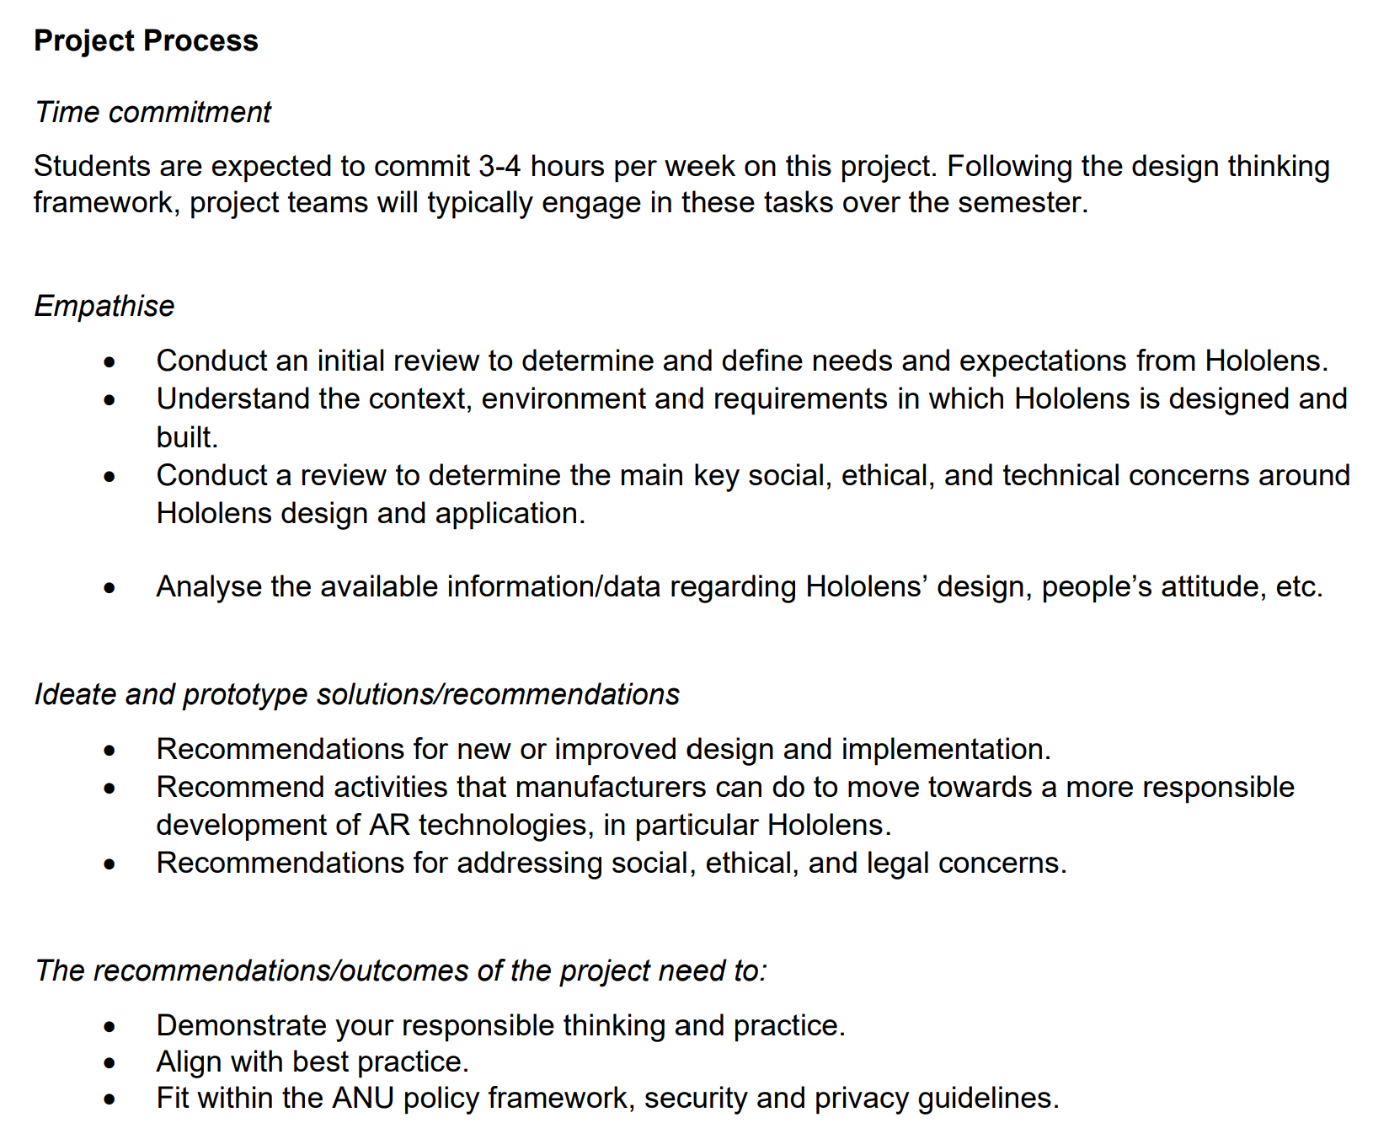

Slide 24
Quick Workshop Project Review
 | Have we completed this task? | How have we completed this requirement? | How can we display we have completed this requirement? | Which Workshop Assessment is this relevant to?
 | Select Yes or No | List Activities Completed (Stakeholder Mapping, Empathy Map, Secondary Research Etc) |  | White Paper, Podcast, Group Presentation, Individual Reflective Piece or Workshop Contribution
Empathise
Conduct an initial review to determine and define needs and expectations from Hololens. | Yes / No
Understand the context, environment and requirements in which Hololens is designed and built. | Yes / No
Conduct a review to determine the main key social, ethical, and technical concerns around Hololens design and application. | Yes / No
Analyse the available information/data regarding Hololens’ design, people’s attitude, etc. Ideate and prototype solutions/recommendations | Yes / No
Ideate and prototype solutions/recommendations
Recommendations for new or improved design and implementation. | Yes / No
Recommend activities that manufacturers can do to move towards a more responsible development of AR technologies, in particular Hololens. | Yes / No
Recommendations for addressing social, ethical, and legal concerns. | Yes / No
The recommendations/outcomes of the project need to:
Demonstrate your responsible thinking and practice. | Yes / No
Align with best practice. | Yes / No
Fit within the ANU policy framework, security and privacy guidelines. | Yes / No

Slide 25
Challenge Set: Global South

Slide 26
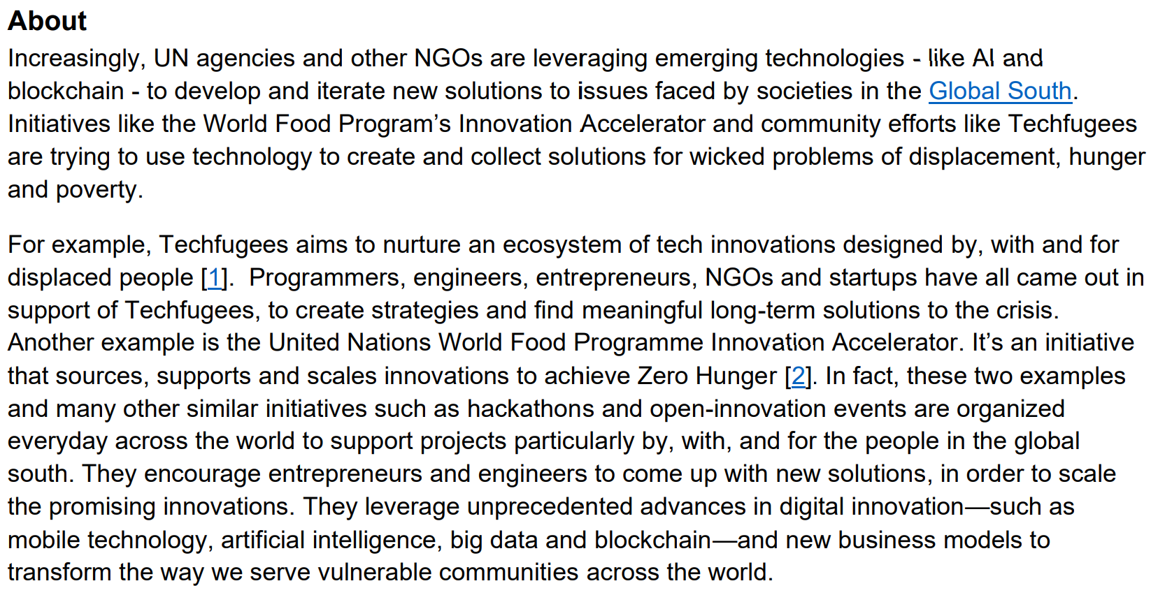

Slide 27
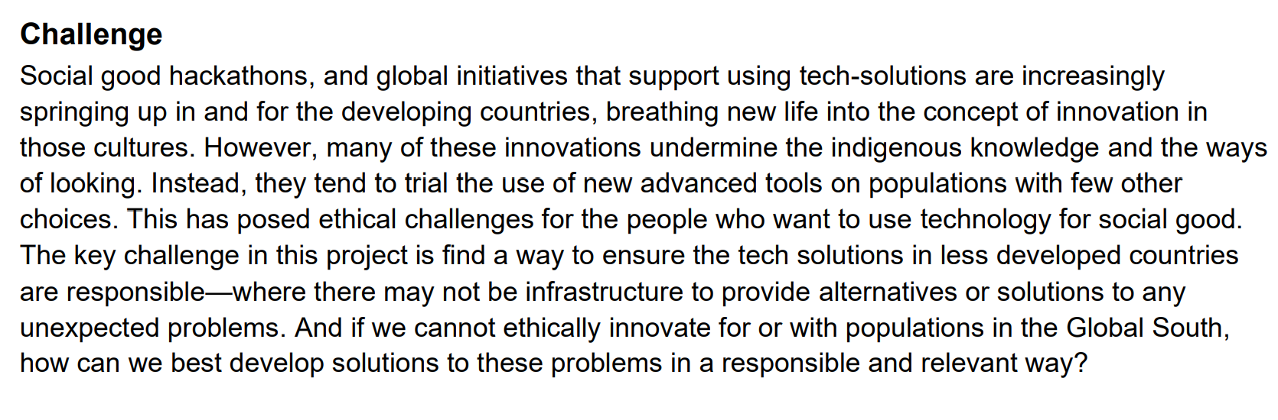

Slide 28
Global South Workshop Project Requirements
 | Yes / No | How has this been achieved? | How / where has this been documented?
Have you?
Identified the social, ethical and technical challenges for the people who want to use technology for social good / hackathons. | Yes / No
Identified how/why/when some technology for social good technology innitiatives undermine the indigenous knowledge and the ways of looking. | Yes / No
Explored the ethical problems created by lack of access to infrastructure, lack of alternatives or limited solutions to any unexpected problems arising from these 'technology for social good projects'. | Yes / No
Identified stakeholders of the 'technology innovation for social good' project as well as their needs and values | Yes / No
Identified a way to ensure the tech solutions in less developed countries are responsible, where there may not be infrastructure to provide alternatives or solutions to any unexpected problems. | Yes / No
Identified how can we best develop solutions to these problems in a responsible and relevant way if we cannot ethically innovate for or with populations in the Global South | Yes / No

Slide 29
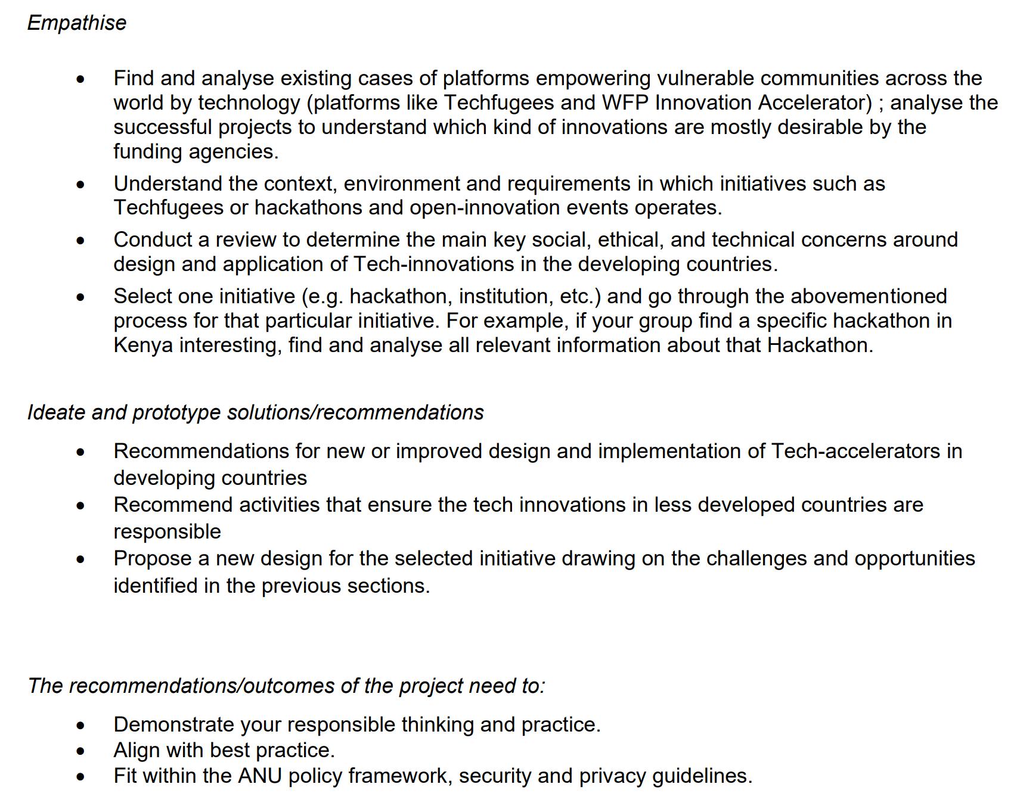

Slide 30
Quick Workshop Project Review
 | Have we completed this task? | How have we completed this requirement? | How can we display we have completed this requirement? | Which Workshop Assessment is this relevant to?
 | Select Yes or No | List Activities Completed (Stakeholder Mapping, Empathy Map, Secondary Research Etc) |  | White Paper, Podcast, Group Presentation, Individual Reflective Piece or Workshop Contribution
Empathise
Find and analyse existing cases of platforms empowering vulnerable communities across the world by technology (platforms like Techfugees and WFP Innovation AccelA4:A8erator) | Yes / No
Analyse the successful projects to understand which kind of innovations are mostly desirable by the funding agencies. | Yes / No
Understand the context, environment and requirements in which initiatives such as Techfugees or hackathons and open-innovation events operates. | Yes / No
Conduct a review to determine the main key social, ethical, and technical concerns around design and application of Tech-innovations in the developing countries. | Yes / No
Select one initiative (e.g. hackathon, institution, etc.) and go through the abovementioned process for that particular initiative. For example, if your group find a specific hackathon in Kenya interesting, find and analyse all relevant information about that Hackathon. Ideate and prototype solutions/recommendations | Yes / No
Ideate and prototype solutions/recommendations
Recommendations for new or improved design and implementation of tech-accelerators in developing countries | Yes / No
Recommend activities that ensure the tech innovations in less developed countries are responsible | Yes / No
Propose a new design for the selected initiative drawing on the challenges and opportunities identified in the previous sections | Yes / No
The recommendations/outcomes of the project need to:
Demonstrate your responsible thinking and practice. | Yes / No
Align with best practice. | Yes / No
Fit within the ANU policy framework, security and privacy guidelines. | Yes / No

Slide 31
PP2 Project Tools

Slide 32
Creating Impact
Where to aim for
Viable
Desirable
Where to start
Feasible

Slide 33
Point of View

Slide 34
Problem Framing

Slide 35
Background Research

Slide 36
Ecosystem Mapping

Slide 37
Stakeholder Analysis Matrix

Slide 38
KML Chart

Slide 39
Empathise

Slide 40
Design Thinking Process
Learn about your users through testing.
What do they say, do and think?
Define the problem by empathising with the users
Test to create new ideas for the project
Empathise
Define
Ideate
Prototype
Test
Learn from prototypes to develop new ideas
Redefine the problem based on the insights from your tests

Slide 41
Empathise Requirements: attitude, etc.
Define needs and expectations from Hololens.
Understand the context, environment and requirements in which Hololens is designed and built.
Conduct a review to determine the main key social, ethical, and technical concerns around Hololens design and application.
Analyse the available information/data regarding Hololens’ design, people’s attitude, etc.

Slide 42
Background Research Ideas
Academic literature
News
Media releases
Magazine articles
Product specifications
Github code base
User reviews / feedback
Twitter
Blogs
What are the recent innovations or developments in the area?
What are other solutions in the area? What has worked? What has not worked?
What feels similar to our potential designs?

Slide 43
The POV Statement
[User … (descriptive)] needs [(need… verb)] because [insight…(compelling)]
The user needs a way to do something that addresses their need so that they benefit directly.
Remember this should be:
Human centred You need to frame the POV statement according to the specific user and their needs. Avoid framing the problem around a technology.
Broad enough to allow creativity Don’t be too specific about the implementation of the solution of the problem.
Narrow enough to make it manageable There have to be some constraints that will show you the right direction of the next steps.

Slide 44
The POV Statement
[User … (descriptive)] needs [(need… verb)] because [insight…(compelling)]
User | Need | Insight
https://www.interaction-design.org/literature/article/define-and-frame-your-design-challenge-by-creating-your-point-of-view-and-ask-how-might-we

Slide 45
Ecosystem Map
Institutions
Services
Community
User

Slide 46
Negative Support / moderate influence
Positive support / High Influence
High
Stakeholder Analysis Matrix
Influence
Who are the stakeholders for this issue?
https://www.smartsheet.com/free-stakeholder-analysis-templates
Negative Support / Minimal Influence
Positive Support / Moderate or Low Influence
Low
Interest
Low
High

Slide 47
Stakeholder Map
?
Funding Bodies
Regulators
Technology Manufactures
Government
?
Users
?
?
Identify stakeholders – one per square
For each stakeholder, add a comment on each square with a quote expressing their thoughts, opinions, or expectations.
Then cluster stakeholders and label the groups.
Draw and label lines among groups to represent the relationships between them such as influence, process, or dependencies
https://www.ibm.com/cloud/architecture/files/design-thinking-field-guide.pdf

Slide 48
Says
Thinks
Saying
Thinking
Empathy Map
User
What are our clients or users doing, thinking and feeling through out the experience?
Does
Feels
Doing
Feeling
https://www.nngroup.com/articles/empathy-mapping/ or https://www.interaction-design.org/literature/article/empathy-map-why-and-how-to-use-it

Slide 49
The Impact Ladder
The lasting social change we would like to contribute to is:
The more near-term outcome that tells us our solution is working is:

Slide 50
Framing the design challenge
The problem we’re trying to solve is:
When framed as a question, our problem is?
The key outcome we’re trying to achieve is?
The important aspects of the context or constraints that we need to consider are:
Some possible solutions to the design questions?
We’re rephrased our original design question. It now says:

Slide 51
Understanding the Problem
 | Problem | Non-Problem | Solution
Who | Has the problem? Is indirectly affected? Believes that they are affected? Makes Decisions? | Is not affected by the problem? | Could use the solution as well? Can contribute to solving the problem? Does not want the solution? Could stand in the way of the solution?
Where | Does the problem occur? | Does the problem not occur? | Has something similar already been successfully resolved? Is the best place to solve it? Could the solution also be used?
When | Did the problem start? Does the problem occur? Does it become an even bigger problem? | Does the problem not occur? | Should the solution be available? Will it improve?
What | Is the problem? Do you know or don't you know about the problem? Is not understood about the problem Is different than it should be? Is particularly noticeable? Annoys you about the problem? Are the individual aspects of the problem? | Is not the problem? | Has been made the solution so far? Should the solution be able to do? Are there constants that cannot or must not be changed? Is needed for the solution? Will be different in future? Is (or is not) important for the solution? Are your goals for the solution? Do you have to discover?
How | Does the problem manifest itself? Is related to another problem? Can it be formulated differently? | Is it going usually? | Should the solution look like? it is tried to be solved so far? Could the problem be an opportunity?
Why | Is it a problem? Is it unusual? | Isn't it a problem for others? | Is the solution needed? Do we want to solve it? Won't it just solve itself? Can it be solved? Is it difficult to solve?
(Based on Müller-Roterberg, 2018, page 13)

Slide 52
Problem Framing and Solution Space
What are all the different ways we can understand this situation?
Problem Framing | Solution Space
Reference: https://hbr.org/2017/01/are-you-solving-the-right-problems

Slide 53
User Interviews, Questions, Observations
How will you achieve some of the following?
Observe
View users and their behaviour:
Observe how users interact with their environment:
Capture quotes:
Behaviour notes:
Ethnography:
Engage
Interact directly:
Survey users:
Ask questions:
Immerse
Live the experience of those we are designing for:
Uncover unconscious needs:
Identify the right users to design for:
If you have specific questions you would like to ask mentors or industry experts please let me know. I will try to facilitate getting them answered.

Slide 54
The Five Whys
The problem we’re trying to solve is:

Slide 55
K – W – L Charts (Know, Want to Know, Learned)
What I Know | What I Want to Know | What I Learned

Slide 56
Ideate

Slide 57
Design Thinking Process
Learn about your users through testing.
What do they say, do and think?
Define the problem by empathising with the users
Test to create new ideas for the project
Empathise
Define
Ideate
Prototype
Test
Learn from prototypes to develop new ideas
Redefine the problem based on the insights from your tests

Slide 58
How Might We:
The problem we’re trying to solve is:

Slide 59
SCAMPER Map
The problem we’re trying to solve is:

Slide 60
Alternative Possible Futures:
Working backwards:
1) Start by imaging the best alternative possible future which achieves the POV.
2) Start with the outcome and then work towards where you are now.
3) Imagine each steps that would need to occur in order to get there, from where you are now.

Slide 61
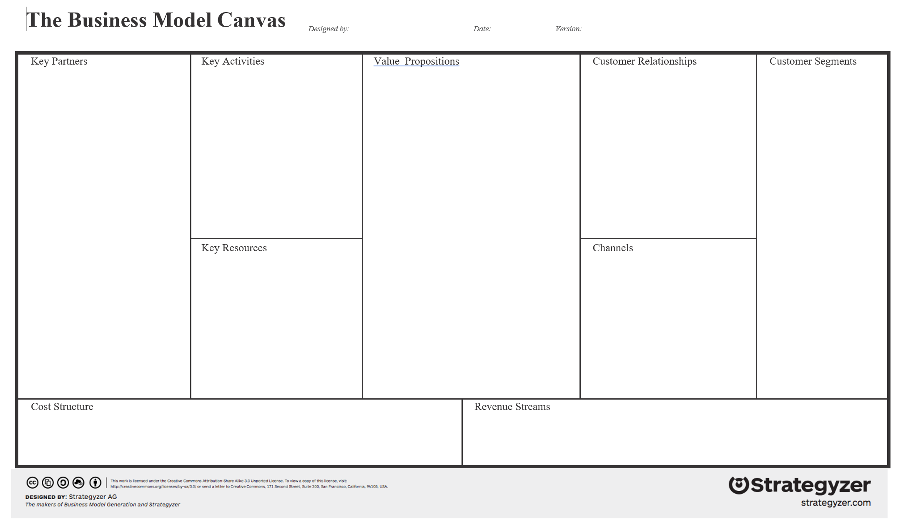
Business Model Canvas

Slide 62
Prototype

Slide 63
Design Thinking Process
Learn about your users through testing.
What do they say, do and think?
Define the problem by empathising with the users
Test to create new ideas for the project
Empathise
Define
Ideate
Prototype
Test
Learn from prototypes to develop new ideas
Redefine the problem based on the insights from your tests

Slide 64
Prototypes
Sketches
Paper Interfaces
Storyboards
Legos Role Plays
MVP Websites
Physical Models
Code Bases

Slide 65
Some Possibly Helpful Tools
Miro https://miro.com/app/
MURAL https://www.mural.co/pricing
Google Docs and Design Sprints https://designsprintkit.withgoogle.com/
Shape by IDEO on GitHub https://github.com/ideo/shape
IDEO Design Kit https://www.designkit.org/
Interaction Design Foundation https://www.interaction-design.org/literature
LucidSpark https://lucidspark.com
PPT Slides
Pen and Paper Drawings

Slide 68
Test

Slide 69
Design Thinking Process
Learn about your users through testing.
What do they say, do and think?
Define the problem by empathising with the users
Test to create new ideas for the project
Empathise
Define
Ideate
Prototype
Test
Learn from prototypes to develop new ideas
Redefine the problem based on the insights from your tests

Slide 74
Tool Map
The problem we’re trying to solve is:

Slide 75
Prioritization Grid
INSTRUCTIONS 1. Draw two axes: Importance to the user (low to high) and Feasibility for us (difficult to easy). 2. Evaluate each item quickly and on your own—roughly plot them on the grid where they make most sense. 3. Once many items are on the grid, begin to discuss with your teammates and reposition them in relation to each other—do certain ideas seem more important or less feasible than others? 4. Avoid spending too much time discussing items that fall into the “unwise” zone unless you believe they have been mis-categorized.
https://www.ibm.com/cloud/architecture/files/design-thinking-field-guide.pdf

Slide 76
Tool Map
The problem we’re trying to solve is:

Slide 77
Design a vase
versus
Design a better way for people to enjoy flowers

Slide 79
Activity 5:
Empathy Mapping

Slide 80
Activity 6:
As Is Scenario Mapping

Slide 81
As is Scenario Map
Phases
Phase
Doing
Doing
What are our clients or users doing, thinking and feeling through out the experience?
Thinking
Thinking
Feeling
Feeling
As is Scenario Map
https://www.ibm.com/design/thinking/page/toolkit/activity/as-is-scenario-map

Slide 82
Activity 7:
Assumptions and Questions Mapping

Slide 83
Assumptions
Questions
Assumptions and Questions.
What assumptions are you making about your project.
What questions do you have about your project?
Let everyone on your team add to the assumptions and questions
A1
Q1
Map out your assumptions, questions and rate them
Assumptions Questions and Actions Map

Slide 84
High Risk
Assumptions and Questions.
What assumptions are you making about your project.
What questions do you have about your project?
Let everyone on your team add to the assumptions and questions
A1
Certain
Uncertain
Map out your assumptions, questions and rate them
Assumptions Questions and Actions Map
Q1
Low Risk

Slide 85
Assumptions and Questions
Means to Resolve your Assumptions and Questions
What options do you have to resolve your questions and assumptions?
This should help you build an action plan to resolve them.
A1
Surveys
Card Sort Activity
Map out your assumptions, questions and rate them
User Interviews
Assumptions Questions and Actions Map

